Slide 1
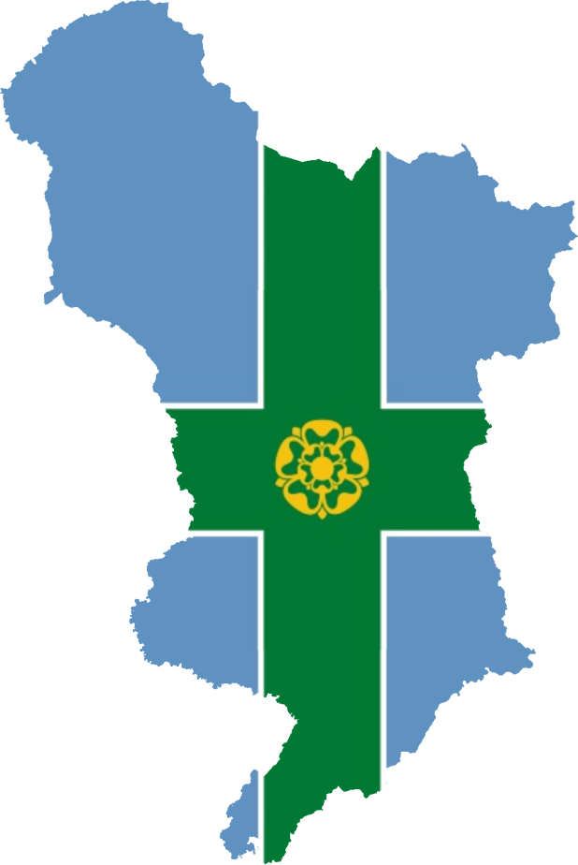
All About Derbyshire

Slide 2
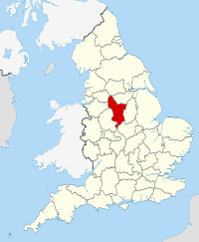
Where is Derbyshire?
Derbyshire is in the middle of the England
It is shrouded by 7 county’s

Slide 3
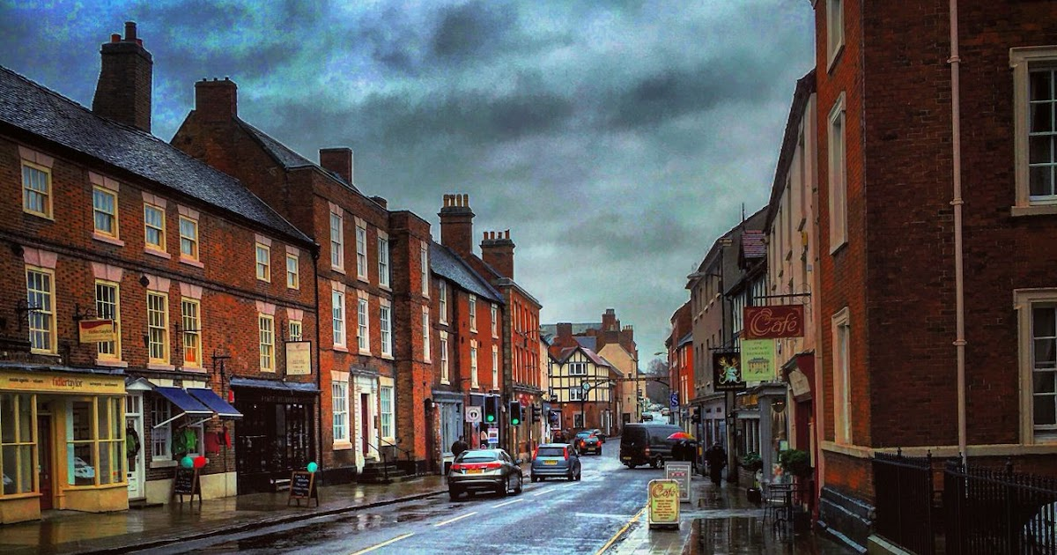
ASHBOURNE

Slide 4
Ashbourne
There are two famous people I know Timothy Dalton ( James Bond)
Ellen Mcarthur (sailor)
Royal shrove tide football
It is scarry so get in a tree!

Slide 5
Landmarks
Thorpe cloude,the Hole in the wall,Lady bower Reservoir,Parwich village,Dovedale,Torpe church.

Slide 6
Nearby towns
Bradley,
Osmaston,
Kniveton,
And Mayfieled

Slide 7
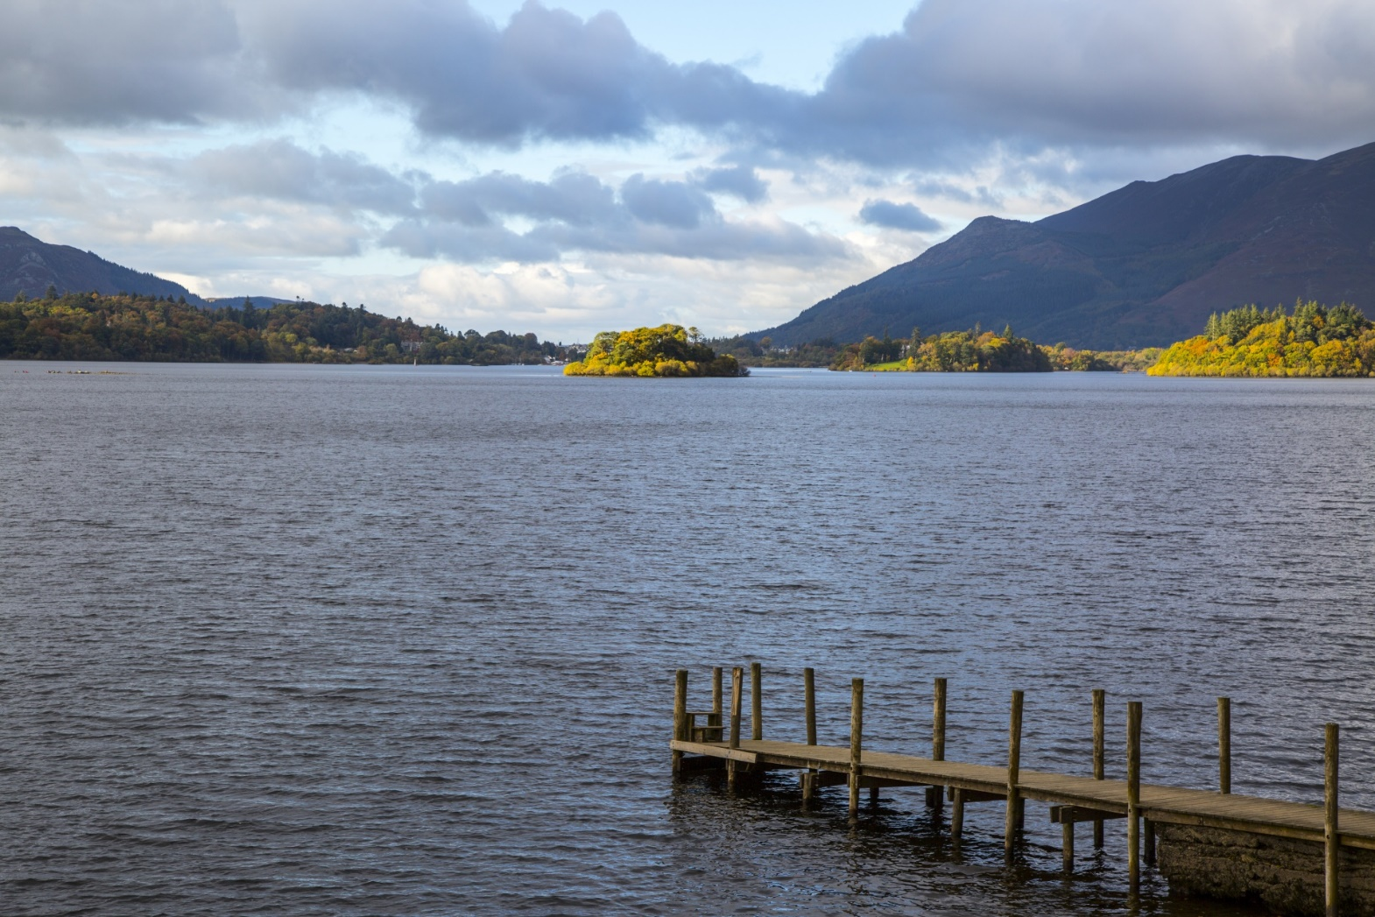
Derwent is the most important river

